Slide 1
ICPAC Guide to Co-produced climate services
Jemimah Wakini Maina
CARE International in Kenya
Regional Climate Services Co-production Capacity Building Officer
17th February 2021

Slide 2
Why an ICPAC Guide to Co-production?
ICPAC has long experience in climate services bridging science and application in sectors
Co-produced climate services involving multi-stakeholder interaction across the knowledge value chain is increasingly popular and endorsed by WMO GFCS
ICPAC and partners have an opportunity to learn and to contribute knowledge and good practices
“The Guide has shown us that ICPAC’s range of services fit together in a coherent way. This is the first time we have pulled together our information on climate services in one place. An important step.” Zewdu Segele, ICPAC

Slide 3
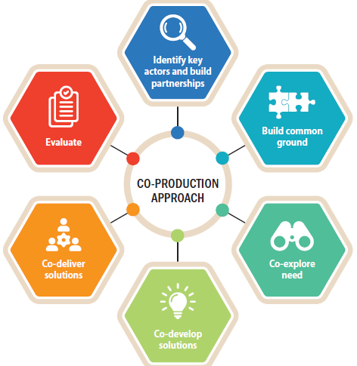
The ICPAC Guide:
Demonstrates practical ways of applying co-production approaches in Eastern Africa region – linking science and social processes
Enables ICPAC to guide development and roll out of fit for purpose climate services for a wide range of decision makers
Enables ICPAC staff to better understand and incorporate user-centred co-production approaches
Builds on the WISER TRANSFORM Manual on coproduction

Slide 4
Key topics covered:
The different categories of actors in co-produced climate services, how to identify them, their roles and how they relate
The different concepts (co-production, user-centered and multi-stakeholder engagement) in climate services
How to design and implement user-centered co-produced climate services with practical examples from ICPAC – including GHACOF
Key guiding principles and building blocks in integrating co-produced climate services in sector platforms

Slide 5
Key topics covered :
Co-production benefits, challenges and opportunities
How to analyse gender issues and integrate gender responsiveness in the design of climate services
Best practices in using communication to ensure multi-stakeholder cooperation and coordination
How to develop and implement an effective monitoring system and suggests possible M&E indicators
Future opportunities for co-produced climate services across the region
Thank you!

