Slide 1
WISER Support to ICPAC Project (W2-SIP)
A Legacy of Improved Climate Services for Managing Climate Extremes over the Greater Horn of Africa
IGAD Climate Prediction and Applications Centre (ICPAC)

Slide 2
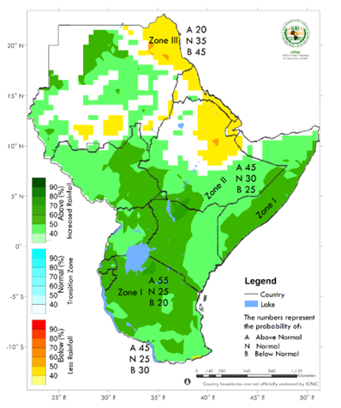
Regional level: Transformational change in regional forecasts
ICPAC introduced objective forecast methodology at GHACOF52 (May 2019, Addis Ababa)
Based on dynamical models: traceable, reproducible, verifiable
Paradigm shift after 20 years of (subjectivity-prone) consensus approach
Facilitated by cross-project collaboration:
HPC cluster from W2SIP (750,000 GBP)
Model evaluation - ForPAc/W2SIP/SWIFT
ICPAC post-processing development - W2SIP/SWIFT
ICPAC regional seasonal rainfall forecast: Oct-Dec 2019
User benefits - gridded format aids new product development
Aligns with recommendations of WMO RCOF/RCC review
Full use of global multi-model infrastructure fostered by WMO
Marking the occasion, GHACOF52: Director of NMA, Ethiopia (centre); WMO; ICPAC; Met Office

Slide 3
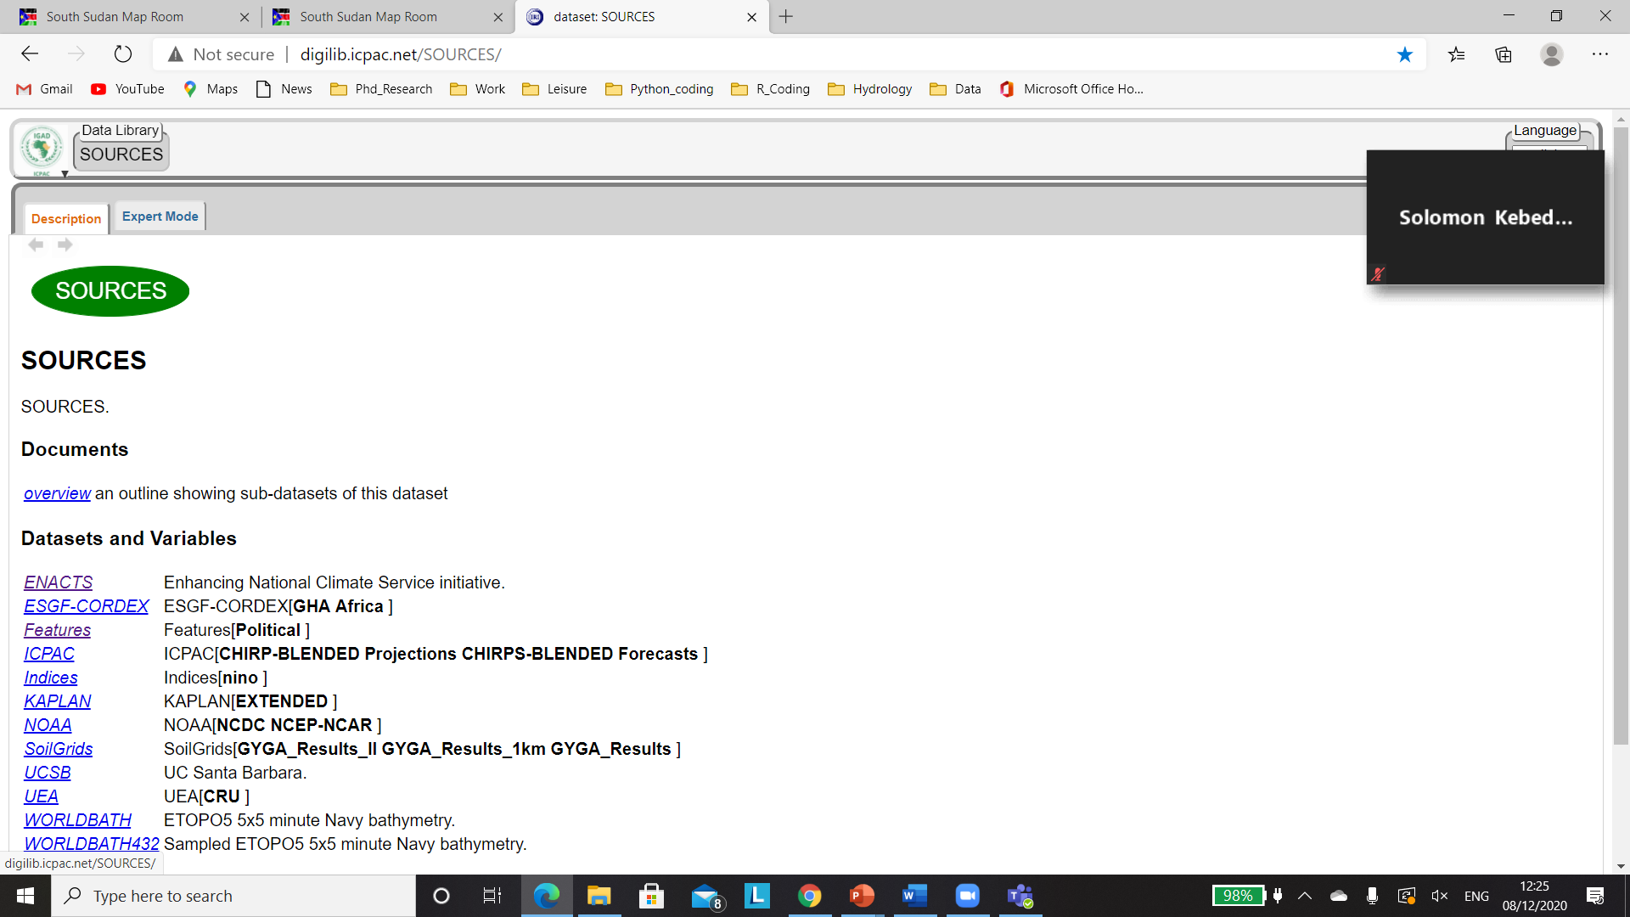
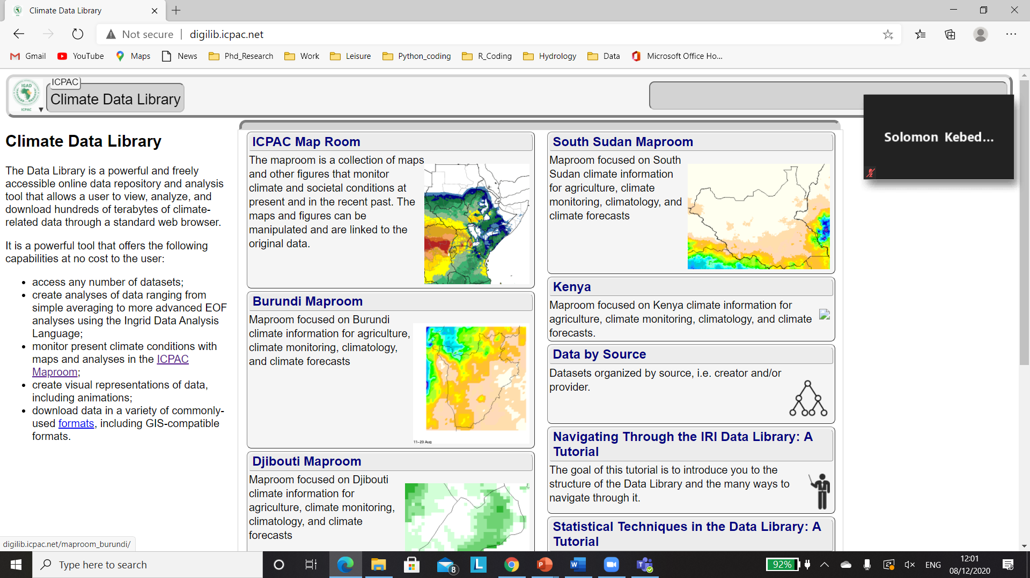
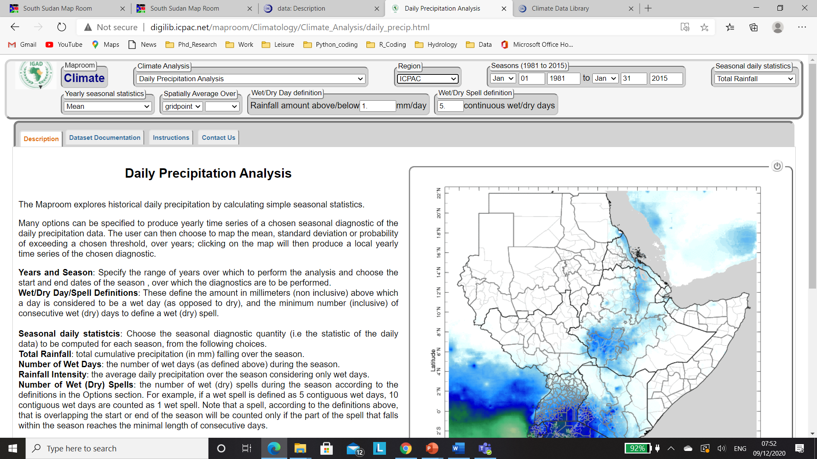
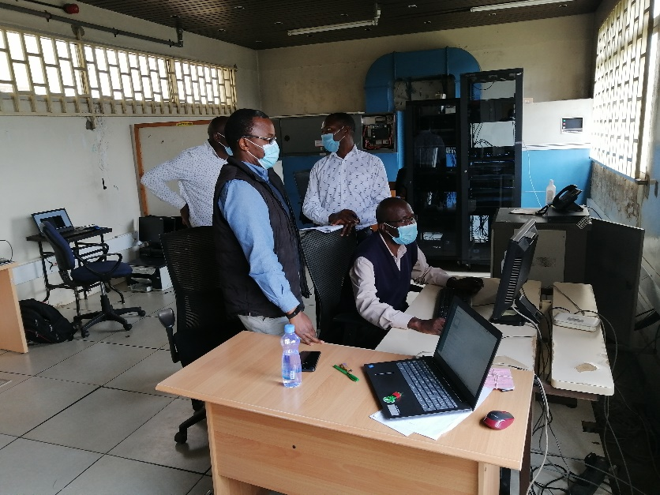
Maproom: Improving Access to Climate Data & Information
Maprooms are web-based applications tailored to specific user needs and applications
Allows for easy navigation, view, and download of data and analysed products
Powerful (based on Ingrid programming language) and fully customizable to suit user needs.
Analysed data can be downloaded in different formats for applications in third party software.
A Library of datasets organized by the source institutions
Key Achievements
ICPAC Maproom
Somalia and South Sudan Maprooms
Updated KMD data in DL
Updated KMD Maproom
Training of KMD planned
The same is planned for Uganda
In the process of introducing flexible forecasts
IGAD Clusters Maprooms

Slide 4
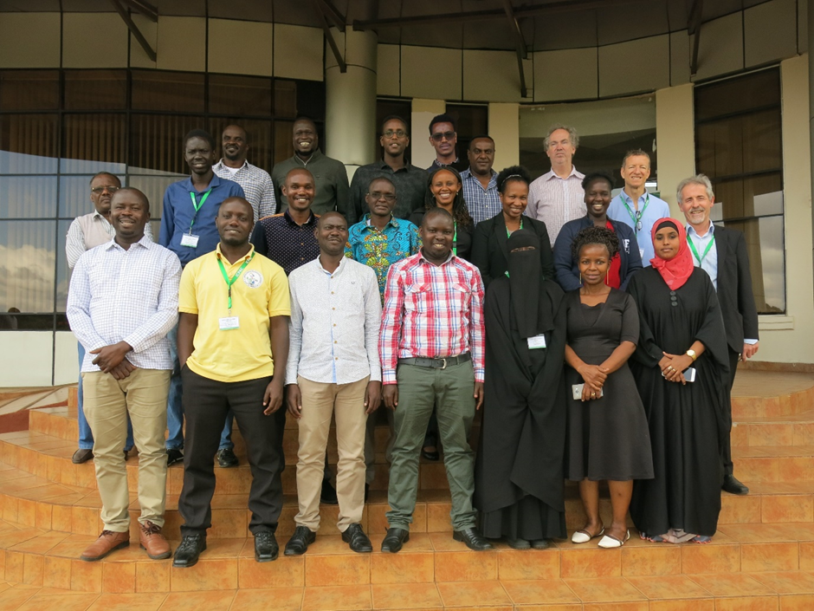
Climate prediction learning events supporting climate service delivery
More than 40 seasonal forecasters from 10 NMHSs trained
Now equipped to access, process and interpret GCM forecast data on the ICPAC HPC cluster…
…to support preparation of objective national seasonal forecasts
Lasting legacy for the climate community in the region
Sustained 1-year programme for each cohort, run three times:
November: Foundational workshop (2-3 weeks)
Jan, May and Aug: consolidate theory with practice at 3 1-week pre-COFs
Remotely facilitated “on-the-job” analysis of GCM forecasts in lead-up to GHACOF
By close of 1-year programme, understanding as well as accuracy and speed of working greatly enhanced.
Participant feedback supports the above
Foundational Seasonal Prediction Workshop, November 2019, one of the first events in ICPACs new building in Ngong.

Slide 5
Coproduced climate services implemented
Over three years of coproduction activities have pulled through to operational, customised KMD seasonal climate services – a climate service milestone
Services are in the form of bulletins to Kenya Red Cross and KenGen, supported by Standard Operating Procedures to aid sustainability
The services complement the KMD national public forecast, providing additional levels of information, tailored to assist:
Red Cross contingency planning and resource allocation
KenGen management of hydropower generation
The services are currently issued for the OND season only, for which the higher predictability supports provision of greater detail.
Consistent with national forecast and based on 4 WMO GPC model predictions
Accurately signalled high risk for the very wet OND 2019 season. Dry conditions signalled for eastern Kenya for OND 2020 were realised (but not in west).
W2SIP Project
Notes:
(self explanatory? In the last bullet I changed “accurate” to “actionable” – since we did underestimate the amplitude of the wet anomalies)

Slide 6
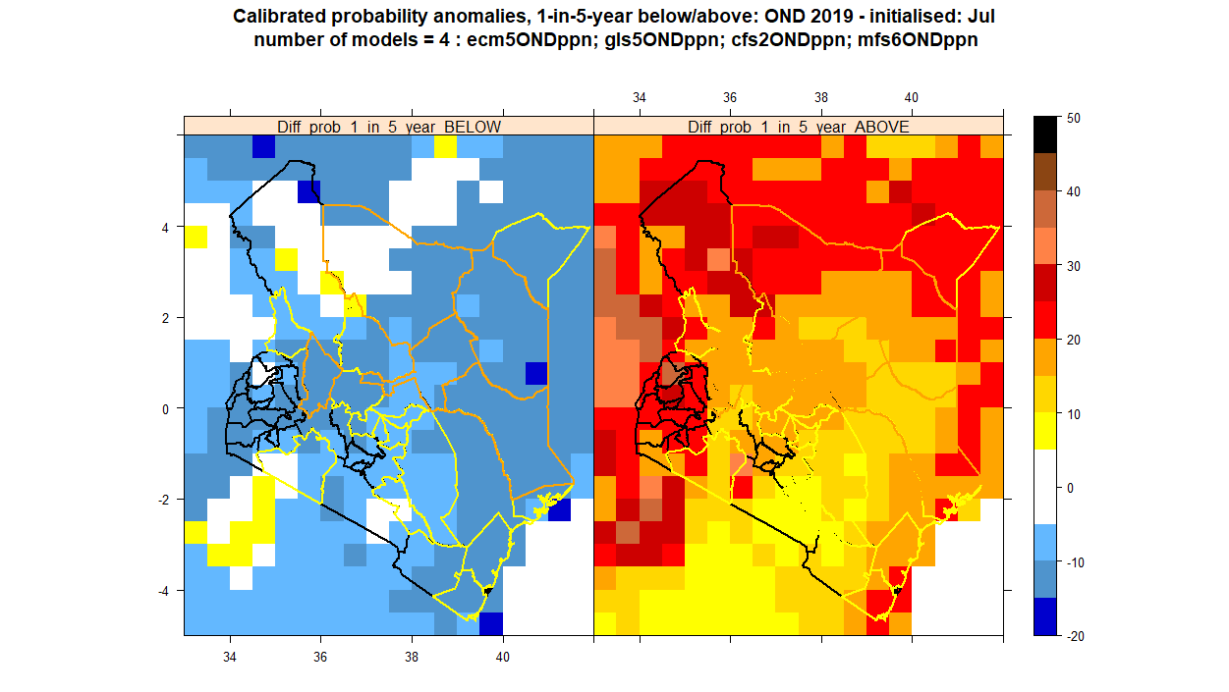
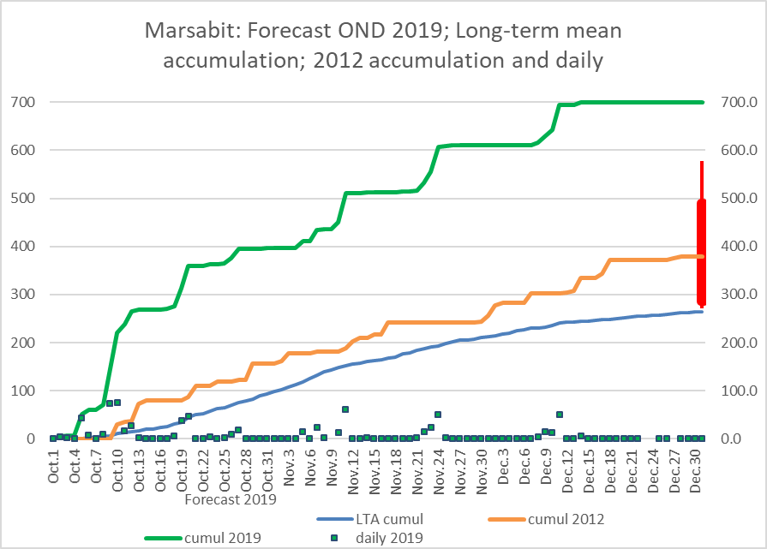
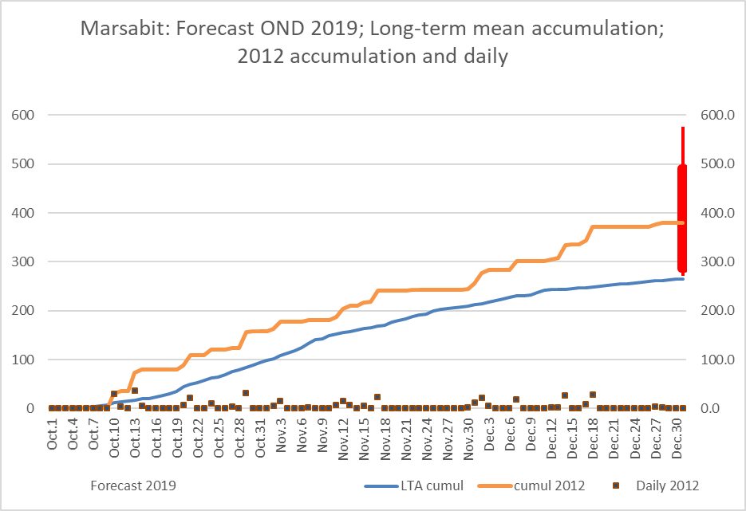
One-in-five year event prediction
Alignment with developing KRCS Early Action Protocols Probability of 1-in-5-year dry and 1-in-5-year wet to aid selection of worst, moderate or best case flood/drought scenario
Forecast 2019 and uncertainty
Marsabit
County boundaries show drought phase
Alert
Alarm
Accumulation
2019
2012
Forecast:
OND 2019
LTA accumulation
Actions/Benefits:
Review and local revision of flood contingency planning.
Pre-positioning of supplies
Training of response teams
General enhanced preparedness
1-in-5 year dry
1-in-5 year wet
probabilities
… in northern, western and eastern regions and in places near the coast... the probability of a 1-in-5-year wet season is 2 to 3 times the usual chance.”
Notes:
This is a product from the KRCS service. KRCS contingency planning is based on expectation of either worst, moderate or best case scenario. And this product is designed to assist selection of appropriate scenario. KRCS have been working expectation of 1-in-5 year wet or dry events, rather than terciles – so this is what the product shows. Note on the right the red colours indicate enhanced chance of a rainfall equal or more severe than experience on average once in years. And the text in the service written below stated: “…in northern, western and eastern regions and in places near the coast the probability of a 1-in-5 year wet season is 2 to 3 times the usual chance.”
click
As part of the coproduction Red Cross were asked by KMD to provide locations (“hotspots”) were sensitivity was particularly high. One of these selected was the Marsabit region – and here the forecast, representative of the region, was presented with added historical context.
The blue shows the location LTA cumulative rainfall curve for OND, the orange the cumulative curve for 2012, a year when there was positive IOD (as 2019, though not as strong). The red box and whisker is the forecast and 70% confidence range – there was high confidence rainfall would be above the LTA, and about 50% chance it would be greater than observed in 2012.
click
The green shows the actual cumulative rainfall for 2019, it was much greater than 2012, and beyond the 70% confidence interval of the forecast. However, the forecast did indicate high chance of exceptional rainfall – if not the very extreme rainfall that occurred. This graphical format was also used to provide Red Cross with updates on performance through the season

Slide 7
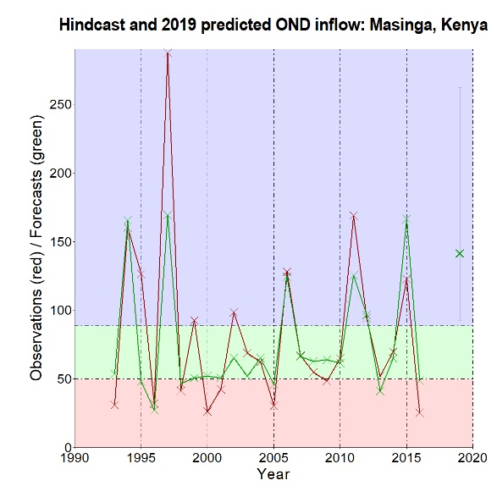
Strengthened reservoir inflow prediction: KenGen
Masinga reservoir: retrospective forecasts for OND inflow 1993-2016 and forecast for 2019, compared with observed inflow (red)
Benefits:
Performance of new method is known (r = 0.82) – unlike the widely-used “analogue year” method
Assists planning of hydropower generation – Masinga reservoir (important for maintaining continuous supply)
Alerts to risk of power shedding (in drought seasons)
Alerts to risk of overflows
Experience contributed to ICPAC’s ”Guide for Engagement in Co-Producing Climate Services”…
…and the WISER-FCFA Co-production Manual
red=observed inflow 1993-2016
green=forecasts, 1993-2016 & 2019
Corr = 0.82
2019 Obs
Oct-Dec inflow (cumecs)
x
2019 Fcast
2020 Obs
Normal
range
x
2020 Fcast
Notes:
This example is taken from the KenGen service. It is an inflow prediction for the Masinga reservoir, one of the main units in Kenya’s hydropower network
A key requirement of coproduction is data sharing between user and producer. KenGen kindly shared their inflow timeseries with us and this enabled us to develop a prediction for the reservoir inflow over the season (in cumecs) – moving beyond rainfall prediction – to flow prediction. We used statistical facilities within IRI’s Climate Predictability Tool.
The historical performance of the forecast is shown by the two timeseries the red is observed inflow, the green the predicted. The good correspondence is clear – with correlation of 0.8. The forecast for OND 2019, with 70% confidence interval is shown at the far right. The central estimate predicted the 4th largest inflow in the 24 years 1993-2016.
Click
The red shows the observed OND inflow, in fact it was the 2nd largest in the 24 years, but within the predicted 70% confidence interval.
Click
Briefly go over the bullets. I hope Willis will moderate these.
In summary the operational services have started well – with actionable guidance given – even if the predicted above normal rainfall and inflow were not as extreme as that observed. I will now hand over to my colleagues from KenGen and Red Cross to share how they used the service, what the benefits were as well as challenges encountered. Starting with ?????. Thank you very much.

Slide 8
THANK YOU VERY MUCH!

