Slide 1





Investing for sustainable climate services:
Insights from WISER experience
- Mairi Dupar, Lena Weingartner, Sarah Opitz-Stapleton

Slide 2
About the presentation
Findings of a study by WISER TRANSFORM on sustainability of climate services investments, which tests concepts in the literature against WISER project experiences
TRANSFORM facilitates the sharing of best practices and learning across the WISER programme (2016 – 2021)
About TRANSFORM

Slide 3
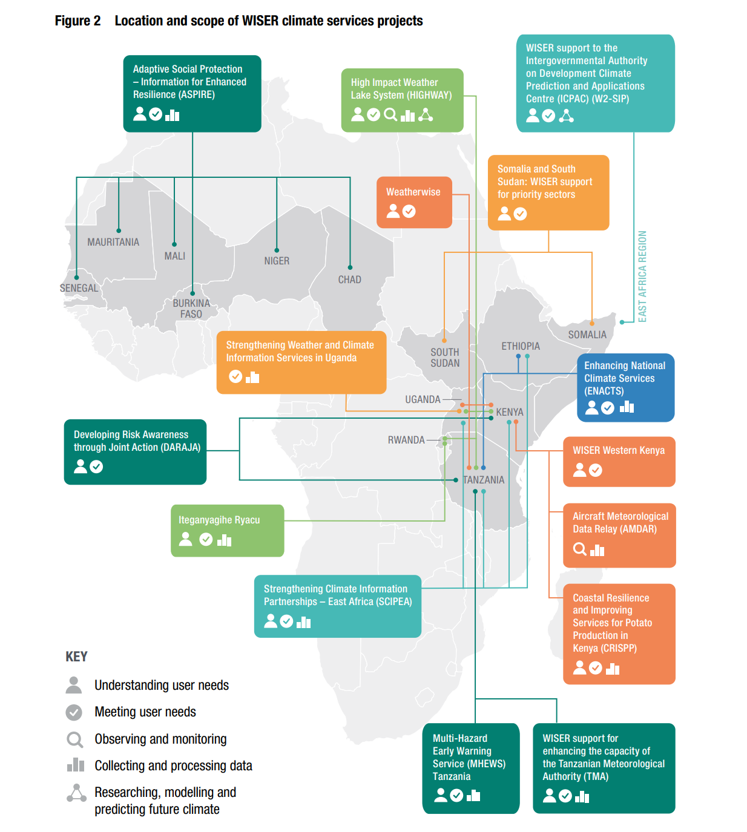
  We studied 15 of the WISER projects, shown here and located mostly in East Africa (but the ASPIRE project spread across West Africa)

Slide 4
Research questions
What elements are necessary to sustain capacity for climate services delivery?
How can sustainability best be incorporated into projects’ design and implementation?
What are the enablers and barriers to creating sustainable capacity? How can the barriers be overcome?

Slide 5
Methods
To understand what elements of sustainable capacity should be:
Literature review
2. To test this against WISER experience and understand more about the constraints and enablers for sustainable capacity:
11 interviews and 10 survey responses from projects (Oct 19 – Jan 20)
Follow up interviews/email consultations with projects (May – Nov 20)
Additional access to project completion reports
Validation workshop with many WISER projects (Nov 20)

Slide 6
Existing guidance for climate services providers
The Global Framework for Climate Services says effective climate services require:
User ‘interface’ > Understanding user needs, meeting user needs
Climate services information system > Collecting and processing data
Observations and monitoring
Research, modelling and prediction
Capacity development
effective ? sustainable
GFCS doesn’t say much about ‘sustainability’ per se but we drilled into each of these areas to understand what climate services providers would need to do – in order to develop sustained capacity across all these areas

Slide 7
Across all the areas of GFCS competency the literature told us that taking the following steps help create sustainable capacity for climate services
…and the WISER projects agreed that these were core elements for sustainability
  (1) Invest in human skills and capacity, both individual and organisational, in addition to hard infrastructure investments, such as computers and observation equipment. Secure a commitment to continue these dual-track investments over time.
  (2) Establish high level buy-in and accountability for providing sustainable, effective weather and climate information services into the future. This should not only be in national hydro-meteorological services (NHMS) themselves, but also in broader government.
  (3) Secure the partnerships, protocols and processes necessary for reviewing and responding to dynamic user needs over time (recognising that user needs for weather and climate information are not static).

Slide 8

Elements of sustainable capacity …continued
  (4) Develop and execute sustainable business models to finance climate services for the long term, which may include a blend of domestic public funding and private finance.
  Continuation of activity with further external funding. (Not really sustainable!)
  Budget mainstreaming by host country governments.
  Commercialisation of all or (more likely) part of the service
  Organisational modernisation to drive efficiencies - save money.

Slide 9
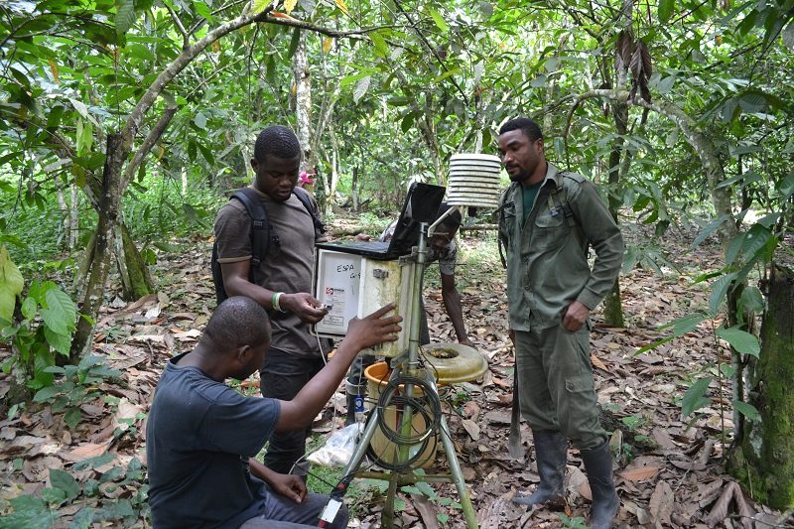
What are the elements of sustainable capacity …cont.?
  (5) Have a sustainability plan for achieving the above elements, from the beginning.
  (And finally) it seems that climate services providers need to be working towards all of the above elements, including sustainable business model, for climate services to be considered ‘on a sustainable footing’. One of these elements alone is not sufficient.

Slide 10
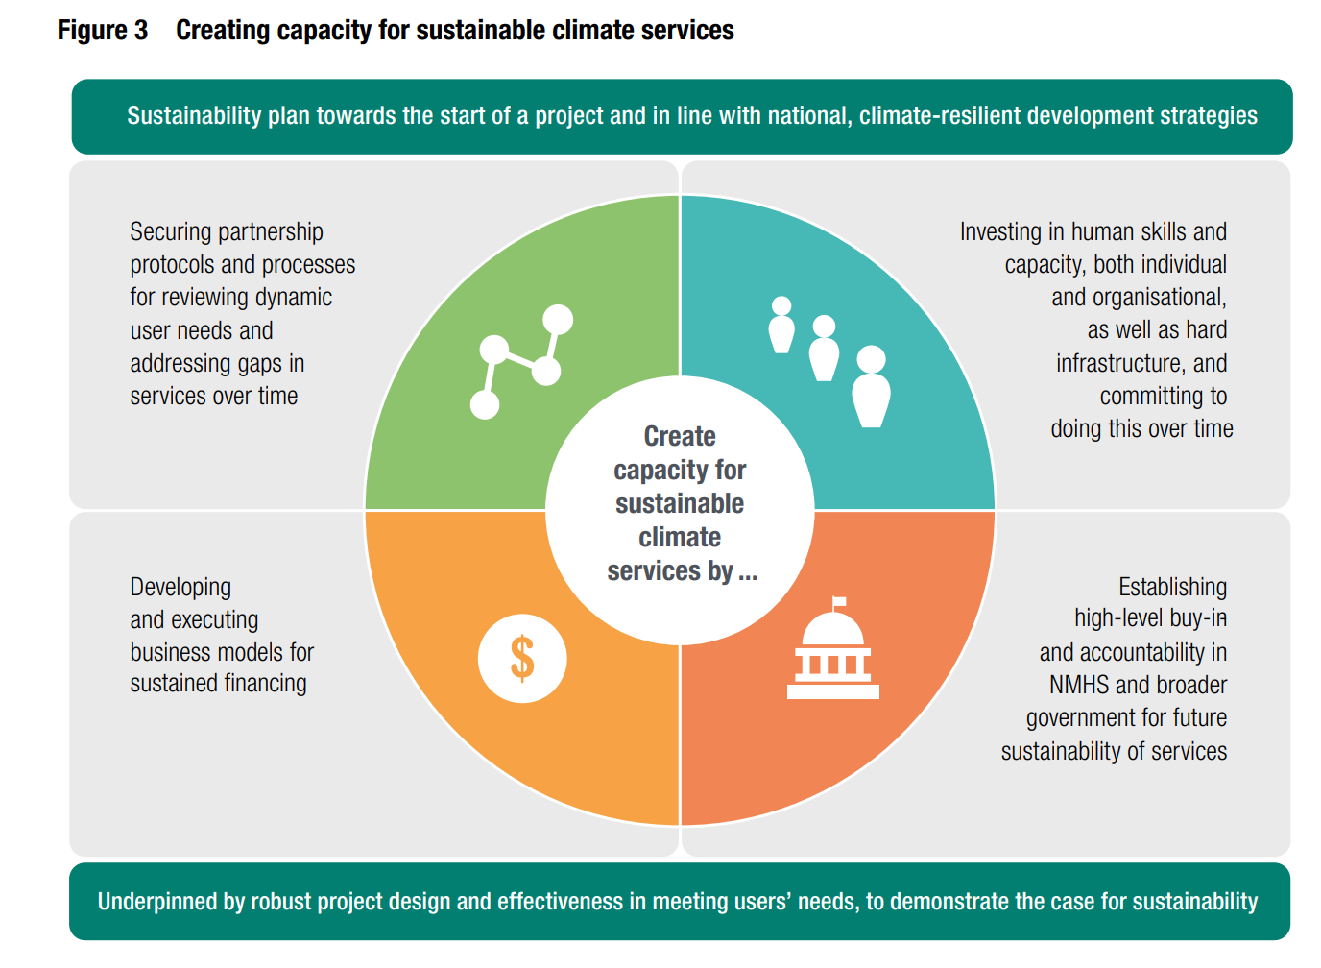

Slide 11
What were the main hurdles to developing sustainable capacity?
  Projects are too short (e.g. 18 months)
  Longer paid project time is needed for effective relationship building and collaborative working, including Memoranda of Understanding, Standard Operating Procedure development, reform organisational efficiency.
  Better M&E would make the case for investment.
  True gender and social inclusion focus (including for people with disabilities) would increase effectiveness of services.
  Political attention and leadership to attract external financing and earmark adequate domestic financing for climate services.

Slide 12
  Keep in touch and let us know if you use the findings!
  Mairi : m.dupar@odi.org.uk
  Lena: l.weingartner@odi.org.uk
  Sarah: s.opitz.stapleton@odi.org.uk
Find the main technical report and the short policy brief version on ODI’s website
https://www.odi.org/publications/17784-investing-sustainable-climate-services-insights-african-experience

