Slide 1
WISER Weather and Climate Information Services for Africa

Slide 2
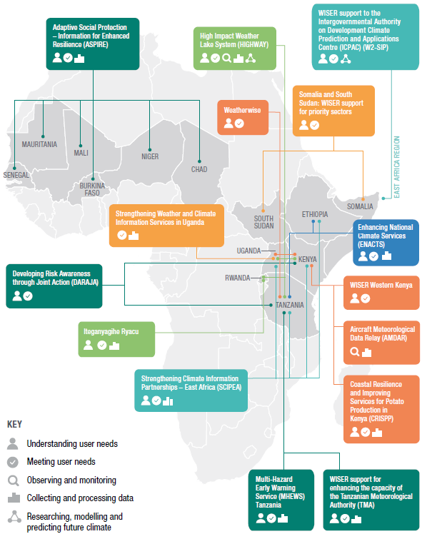
WISER Projects:
Pilot (2016-18) Phase 2 (2017-2021)

Slide 3
WISER Phase 2: Preliminary Insights
Access to Improved WCIS
Current analysis suggests 2.7M households with improved access.
Using Improved WCIS
Current analysis suggests 400K households actually using improved WCIS

Slide 4
WISER Phase 2: Preliminary Insights
People with Resilience Improved: Target 14M
Avoided Losses: Target £190M / Current £120M*
*only 50% of projects analysed so far
Estimated Socio-Economic Benefits
HIGHWAY: £76M over 10yrs. Saving 312 lives p/a
Strengthening WCIS Uganda: £24M over 10yrs

Slide 5
WISER Phase 2: Next Steps
Learning
Summarise learning at Programme Level
WISER Learning Event with Projects in April
WISER GHACOF Side Events this Afternoon

Slide 6
Questions
Dr Tom James, WISER Senior Projects Manager
e: tom.james@metoffice.gov.uk / WISER@metoffice.gov.uk

