Slide 1
MAINSTREAMING WEATHER AND CLIMATE IN RADIO
DISCUSSIONS WITH RADIO JOURNALISTS & METEOROLOGISTS

Slide 2
MAINSTREAMING WEATHER AND CLIMATE IN RADIO
Introduction
Weather affects everyone and everything it its path, beginning with the clothes you put on to meet your day to the type of outdoor activities you choose to engage in.
Weather impacts human, animal and plant health, as well as the food supply, in any location.
Floods and water damage, wind and all the other ancillary hazards associated with weather are a major concern of business (as well as residential) property.

Slide 3
MAINSTREAMING WEATHER AND CLIMATE IN RADIO

Slide 4
MAINSTREAMING WEATHER AND CLIMATE IN RADIO
Introduction
Weather and climate play a big role in the fruits and vegetables people eat in any location in the region.
With limited growing seasons in some parts of the region as certain foods and vegetables are simply not ‘growable’ and must be transported from other parts of the region.

Slide 5
MAINSTREAMING WEATHER AND CLIMATE IN RADIO
WEATHER IS EVERYTHING
This means that the market prices in the various district markets rely on the weather to determine if they go up or down.
From a business perspective, weather can have a significant impact on the bottom line earnings. And as with most patterns of this type, bad times are usually balanced out with good times.

Slide 6
MAINSTREAMING WEATHER AND CLIMATE IN RADIO
WEATHER IS EVERYTHING
However in order to “weather the storm” during those bad times, business owners need to be prepared for it. And this doesn't just go for seasonal businesses, either.
Businesses of all kinds can be affected, even if indirectly, by both good and bad weather.
Another way weather can impact businesses is with scheduling and consistency.

Slide 7
MAINSTREAMING WEATHER AND CLIMATE IN RADIO
WEATHER IS EVERYTHING
Weather delays can cause some businesses to lose days at a time either directly impacting sales or otherwise cause projects to be delayed requiring expensive catch-up work.
It's important to maintain a level of contingency and/or flexibility to limit these effects.
Weather has a profound effect on human health and well-being.

Slide 8
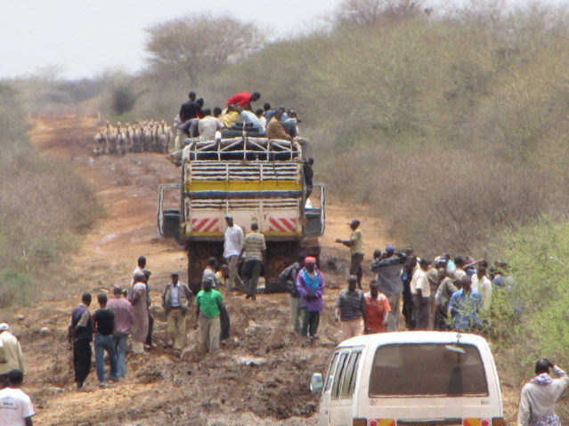
MAINSTREAMING WEATHER AND CLIMATE IN RADIO

Slide 9
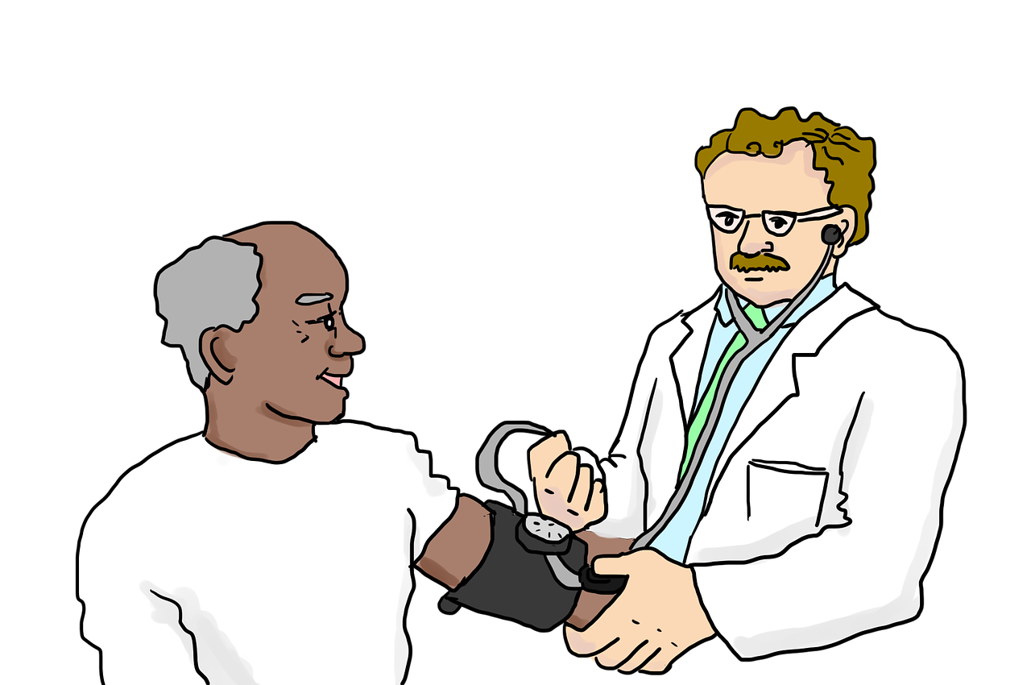
MAINSTREAMING WEATHER AND CLIMATE IN RADIO
WEATHER IS EVERYTHING
It has been demonstrated that weather is associated with outbreaks of pneumonia, influenza and bronchitis, cholera, bilharzia, malaria etc.
Weather and climate information thus cuts across all sectors of the economy generally and it is important that weather and climate information be used to provide mitigating options to the end users.

Slide 10
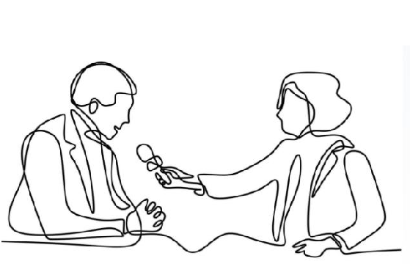
MAINSTREAMING WEATHER AND CLIMATE IN RADIO
RADIO REPORTERS ROLE IN MAINSTREAMING WEATHER & CLIMATE INFORMATION
Bringing queries and information needs of the community members to the meteorologists.
Disseminating information from the meteorologists to the rural communities in different parts of the region in simple, easy to understand language.

Slide 11
MAINSTREAMING WEATHER AND CLIMATE IN RADIO
RADIO REPORTERS ROLE IN MAINSTREAMING WEATHER & CLIMATE INFORMATION
Communicating information on government policies relating to climate resilient agriculture to the rural population.
Presenting problems of the community and how they are getting affected by climate change to policy makers helping them formulate more effective policies to help vulnerable communities cope with the changing climate.

Slide 12
MAINSTREAMING WEATHER AND CLIMATE IN RADIO
PROVIDING WEATHER AND CLIMATE INFORMATION
In rural areas, of the region, the poor remain isolated from various forms of media. Illiteracy, affordability, and lack of access to electricity are all barriers for access to different forms of media.
Radio is a medium that can overcome these barriers. Community radio can play an important role in initiating a two-way communication process between the community and the county level meteorologists and government officials, which is currently a lacuna.
Radio journalists can provide access to information and serve as an interactive medium where citizens can ask questions and raise their concerns regarding weather climate issues.

Slide 13
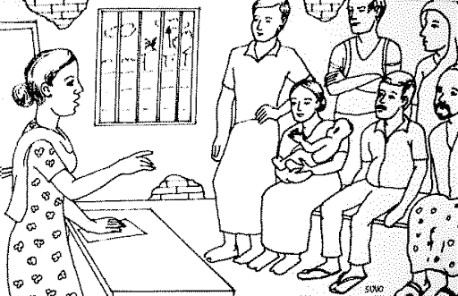
MAINSTREAMING WEATHER AND CLIMATE IN RADIO
PROVIDING WEATHER AND CLIMATE INFORMATION
Radio reporters can take the voices and concerns of the community to the meteorologists and local level decision makers.
They can also address the priority concerns of the community by ensuring that the relevant information available with meteorologists and decision makers is brought to them.

Slide 14
MAINSTREAMING WEATHER AND CLIMATE IN RADIO
MAINSTREAMING TECHNIQUES
In the weather climate context, mainstreaming refers to the incorporation of weather and climate considerations into established or on-going development programs, policies or management strategies, rather than developing adaptation and mitigation initiatives separately.
Consequently in light of radio, mainstreaming of weather and climate, the assumption is that weather and climate is an integral part of day to day life and hence this can be reflected in radio programming.

Slide 15
MAINSTREAMING WEATHER AND CLIMATE IN RADIO
MAINSTREAMING TECHNIQUES
Health radio shows (water and vector borne diseases)
Prices in the market radio shows (cost of fruits and vegetable and other produce)
Agriculture radio shows (preseason planning and post-harvest handling).
Sports radio shows (Local football matches in different parts of the region.

Slide 16
MAINSTREAMING WEATHER AND CLIMATE IN RADIO
EXAMPLE 1 WEATHER & CLIMATE RADIO VOX POP
The term "vox pop" comes from the Latin phrase vox populi, meaning "voice of the people".
The vox pop is a tool used in many forms of media to provide a snapshot of public opinion.
Random subjects are asked to give their views on a particular topic and their responses are presented to the viewer/reader as a reflection of popular opinion.
For radio vox pops, the interviewer approaches people and asks them simple questions about weather and climate forecasts etc.

Slide 17
MAINSTREAMING WEATHER AND CLIMATE IN RADIO
EXAMPLE 2 USE OF ICPAC PRODUCTS E.G. EAST AFRICA HAZARDS WATCH
The East African Hazards Watch
https://eahazardswatch.icpac.net

Slide 18
MAINSTREAMING WEATHER AND CLIMATE IN RADIO
RADIO CLIMATE DEBATES
Meteorologists and journalists have used the venue of public broadcasting to discuss climate change.
In the region this has been patchy, it calls for formalization. Radio journalists and meteorologists have repeatedly communicated the science of human-driven climate change and its impacts in interviews, call-in radio shows, debates, public lectures, news programs, and documentaries.
It is essential that these debates be institutionalized in radio to weekly or twice a month basis. That way the mainstreaming will succeed. The guests too have to change and lines opened for more communication from the end users.

Slide 19
Thank you!
www.icpac.net

