Slide 1
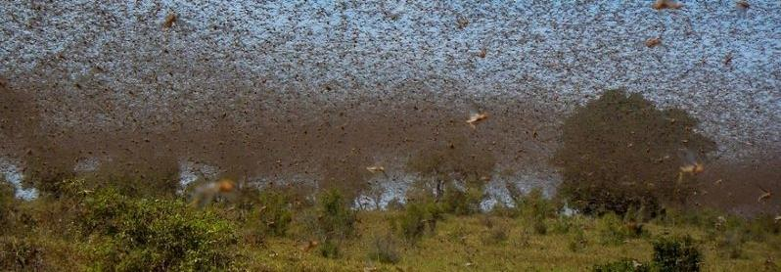
Regional Platform of the Sustainable Management of Desert Locust
2 December 2021

Slide 2
Lessons from the 2019-2021 Desert Locust Upsurge
2018
Cyclone Mekunu (MAY)
2019
East African rainfall 400% of normal
2020
Cyclonic Storm Luban (OCT)
Cyclone Pawan (DEC)
Cyclone Gati (NOV)
FAO desert locust warning (DEC)
IGAD press release (JAN)
World Bank ERLP 1 and 2 (MAY/JUN)
FAO Appeal (JAN)
2021
Dialogue on desert locust (JAN-MAY)
IGAD Ministerial (FEB and MAY)
World Bank ELRP 3 (JUN)
World Bank ELRP 4

Slide 3
The Emergency Locust Response Program Components
1. MONITOR & CONTROL
Structure aligns with FAO in approach and all control efforts follow the FAO guidance
Key lessons learned from the 2003-2005 locust invasion in West Africa showed the need for livelihood support as a key component in the response efforts
Building on existing WBG projects
ELRP
2. PROTECT & RESTORE
Increasing national preparedness
Increasing regional coordination and collaboration
3. PREPARE & COORDINATE
Notes:
First, there is “control”, the need to help affected countries monitor and assess looming locust dangers, control locust population growth, and curb their spread, while mitigating the risks associated with control measures.
Second, there is “protect and restore”; countries need to move immediately to improve access to food and basic services for the vulnerable in the shortterm, but also to secure the means to generate livelihoods and enhance human capital assets in the future. This pillar requires social protection and technical interventions in agriculture and livestock to prevent further food insecurity and permanent loss of human capital and productive assets. Productive assets such as livestock and other forms of household working capital are often sacrificed when households have no other way to cope with shocks.
Third, there is “preparedness”, the need to deal with the fact that the current outbreaks are climate-related and are likely to reoccur more frequently under climate change.
monitoring and controlling locust population growth and curbing the spread of swarms while mitigating the risks associated with control measures;
protecting and rehabilitating the livelihoods of locust-affected households to prevent human capital and asset loss, ensure food security, and return them to productivity; and
preventing future locust upsurges by strengthening capacity for ex ante surveillance and control operations to facilitate national and regional early warning and early.

Slide 4
The Emergency Locust Response Program Participants
Phase 1
Ethiopia
Kenya
Phase 2
Somalia
Phase 3
South Sudan
IGAD
Djibouti
Phase 4
Sudan
Notes:
First, there is “control”, the need to help affected countries monitor and assess looming locust dangers, control locust population growth, and curb their spread, while mitigating the risks associated with control measures.
Second, there is “protect and restore”; countries need to move immediately to improve access to food and basic services for the vulnerable in the shortterm, but also to secure the means to generate livelihoods and enhance human capital assets in the future. This pillar requires social protection and technical interventions in agriculture and livestock to prevent further food insecurity and permanent loss of human capital and productive assets. Productive assets such as livestock and other forms of household working capital are often sacrificed when households have no other way to cope with shocks.
Third, there is “preparedness”, the need to deal with the fact that the current outbreaks are climate-related and are likely to reoccur more frequently under climate change.
monitoring and controlling locust population growth and curbing the spread of swarms while mitigating the risks associated with control measures;
protecting and rehabilitating the livelihoods of locust-affected households to prevent human capital and asset loss, ensure food security, and return them to productivity; and
preventing future locust upsurges by strengthening capacity for ex ante surveillance and control operations to facilitate national and regional early warning and early.

Slide 5
Drilling Down on Regional Preparedness
Djibouti
Ethiopia
Kenya
Uganda
South Sudan
Somalia
IGAD
IGAD Communique committing to 14 priority actions across 4 actions:
(a) strategies & preparedness;
(b) regional collaboration;
(c) governance & coordination; and
(d) research & innovation
Establishes an inter-regional platform to facilitate exchanges between frontline and invasion countries

Slide 6
Lessons from the 2019-2021 Desert Locust Upsurge
2018
Cyclone Mekunu (MAY)
2019
East African rainfall 400% of normal
2020
Cyclonic Storm Luban (OCT)
Cyclone Pawan (DEC)
Cyclone Gati (NOV)
FAO desert locust warning (DEC)
IGAD press release (JAN)
World Bank ERLP 1 and 2 (MAY/JUN)
FAO Appeal (JAN)
2021
Dialogue on desert locust (JAN-MAY)
IGAD Ministerial (FEB and MAY)
World Bank ELRP 3 (JUN)
World Bank ELRP 4

